Slide 1
PP Mini-Project
Hangman Game
FY COMPS Sem II ( 2022-23)
Batch C2-1
Kashish Mamania
16010122104

Slide 2
Problem Statement
Develop a Hangman game that reads a list of words from a file and randomly selects one word as the secret word for each playthrough. The game should allow the player to guess letters until they either guess the word correctly or run out of attempts. The game should run such that the player doesn't repeat a guess and that only single letters are entered. The game should keep track of the player's progress, display the masked word with correctly guessed letters revealed, and provide feedback on the number of attempts remaining.

Slide 3
System Architecture
Start Game: The game starts at this point.
Load Words: The system loads the words from the words.txt file or any word list database.
Choose Word: The system randomly selects a word from the loaded word list.
Play Game: The main gameplay loop where the user interface and game logic interact.
User Interface: The player interacts with the game through the user interface, entering their guesses.
Get Guess: The user interface component captures and provides the player's guess to the game logic.
Check Guess: The game logic component checks if the guess is correct or incorrect.
Update Display: The user interface component updates the display to show the current state of the game, including the masked word and the number of attempts remaining.
Check Win/Lose: The game logic component checks if the player has won by guessing the word correctly or lost by running out of attempts.
Repeat or End: Depending on the outcome of the game, the system either repeats the gameplay loop or proceeds to end the game.
End Game: The game ends at this point.

Slide 4
System Architecture
The Hangman class serves as the central component, responsible for managing the game's state and controlling the gameplay.
The class constructor __init__() initializes the instance variables with default values.
The choose_category() method prompts the user to choose a category from a predefined list and returns the selected category.
The choose_difficulty() method prompts the user to choose the difficulty level (easy, medium, hard) and sets the maximum number of attempts accordingly.
The load_words() method takes a category as input, reads the corresponding category file, and returns a list of lowercase words.
The get_masked_word() method generates a masked version of the word, where unknown letters are represented by underscores.
The play() method implements the main game loop. It initializes the game, selects a word, and interacts with the user for guessing the letters. It also handles win/lose conditions and prompts for playing again.
The ask_play_again() method asks the user if they want to play again and restarts the game if the answer is "yes."
The main program creates an instance of the Hangman class and starts the game by invoking the play() method.

Slide 5
Features of designed System
The design system for the Hangman game has some important features:
Modular and Scalable: The system is designed in a way that makes it easy to add new features without causing problems. It is divided into different parts, each handling a specific task.
Separation of Concerns: The system separates different tasks into their own parts. For example, one part deals with how the game looks and interacts with the player, while another part handles the rules of the game.
Reusability: The system is built so that parts of it can be used again in different situations. For example, the code that reads word lists can be used to load different lists from different files.
Configurability: The system can be easily customized to change certain aspects of the game. For example, you can change the maximum number of attempts or make the game harder or easier.
Data Persistence: The system can load words from a file, which means you can easily change or update the words without changing the code.

Slide 6
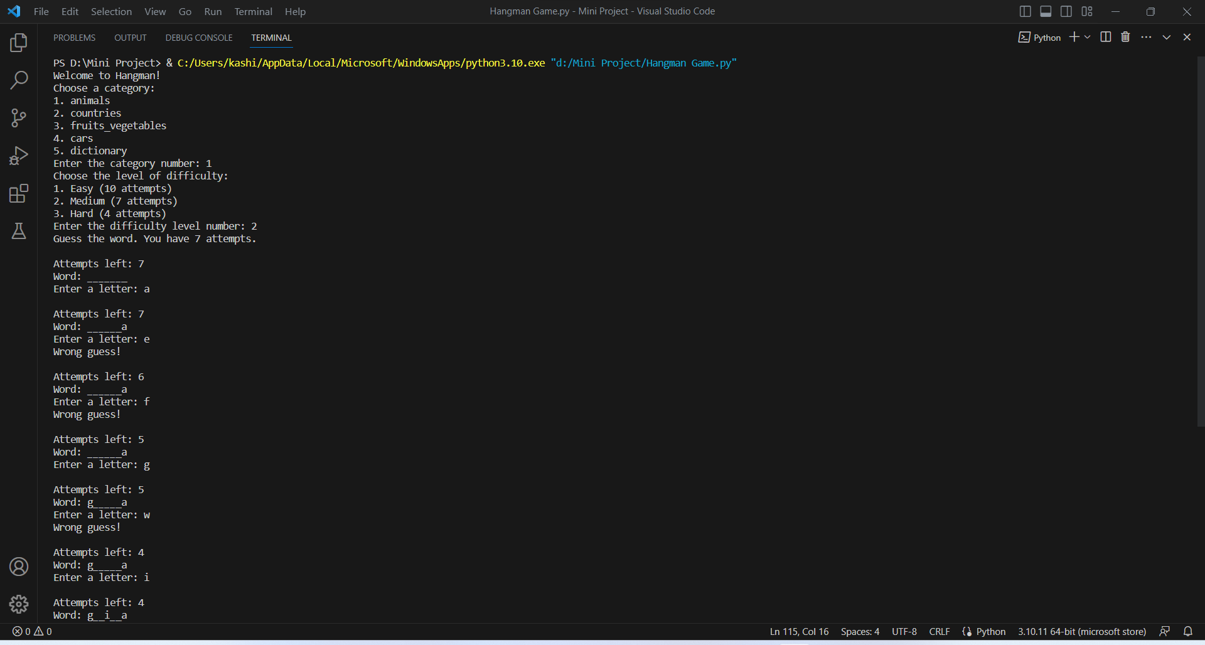
Result

Slide 7
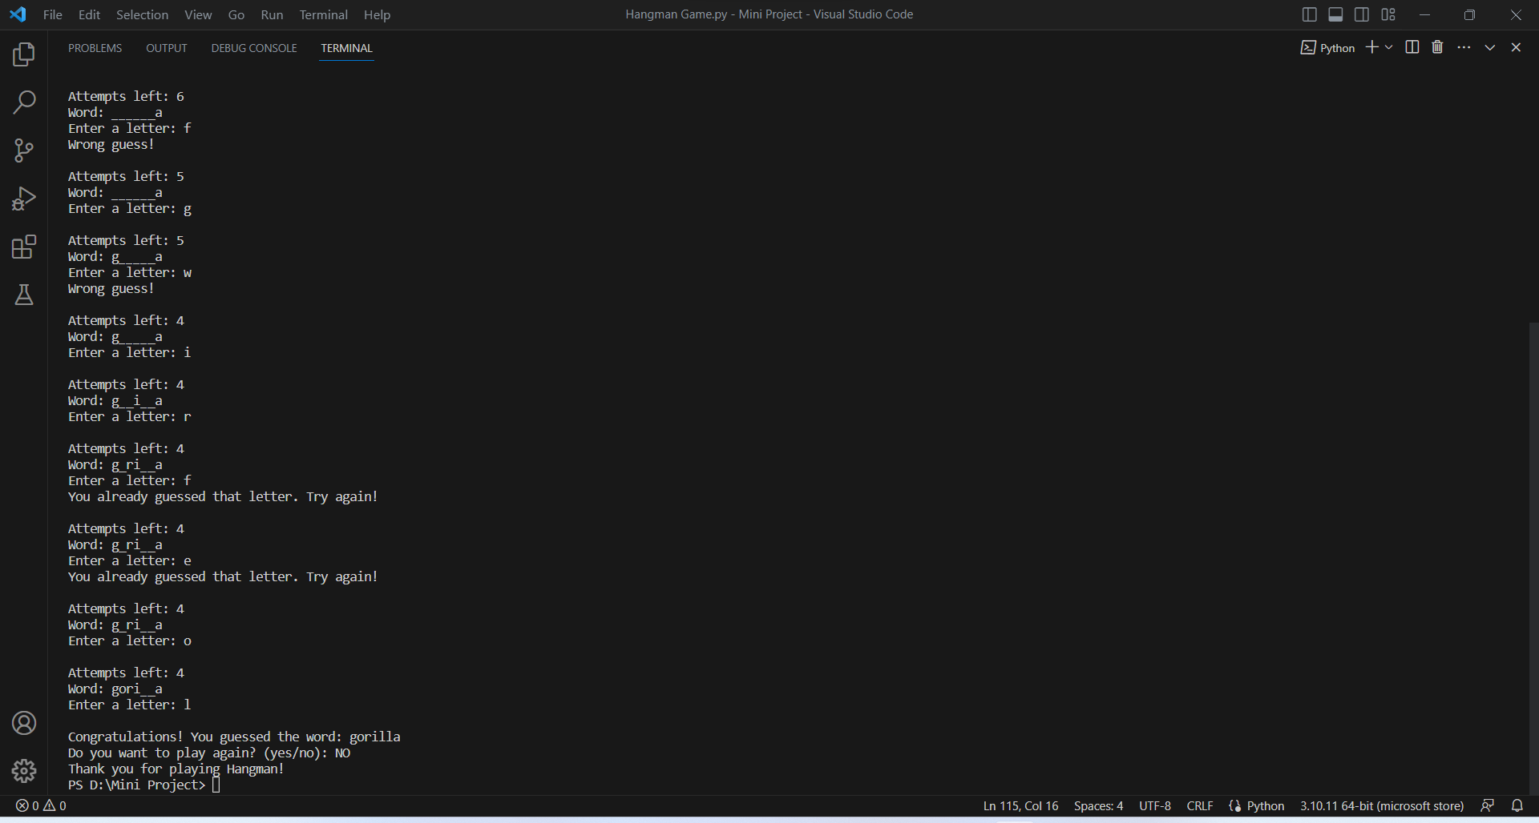
Result

Slide 8
Conclusion
The Hangman game utilizes object-oriented programming principles. I Created a class to represent the Hangman game, which includes methods for loading words from a file, managing guesses and attempts, and checking the validity of the player's input. The game provided a user-friendly interface, displaying the masked word and relevant information throughout the gameplay, and offering appropriate feedback based on the player's guesses.

Slide 9
References
For the code:
https://www.geeksforgeeks.org/hangman-game-python/amp/
https://www.geeksforgeeks.org/file-handling-python/
https://www.geeksforgeeks.org/difference-between-system-architecture-and-software-architecture/
https://www.interviewbit.com/blog/system-architecture/
For the lists:
https://github.com/dwyl/english-words
https://www.britannica.com/topic/list-of-countries-1993160
https://www.car.info/en-se/brands
https://plantprosperous.com/list-of-fruits-and-vegetables/
https://a-z-animals.com/animals/

